Slide 1
Intro to Deep Learning for the Absolute Beginner
Esteban (EJ) Guillen
https://github.com/EstebanGuillen/DeepLearningClass
Notes:
Hello and welcome to this course on Deep Learning

Slide 2
Who am I
Member of technical staff
BS Computer Engineering (K-State)
Masters Software Engineering (K-State)
Fall 2015 UNM
PhD?
Machine Learning
Fall 2016 PhD student
Deep Learning (Computer Vision)
Working with a Radiologist at UNM Hospital
Deep Learning has potential at Sandia
Need to develop necessary skills

Slide 3
Who are you
Name
Basic background (type of work you do)
Why you are taking this class
What you hope to learn

Slide 4
Course Goal
Understand what it means for a computer to learn
Become familiar with the terminology
Get hands-on experience
You will write code
Be able to explain what Deep Learning is
Understand how you could apply Deep Learning

Slide 5
What we will cover (lessons)
What is Machine Learning (1)
Math Background (1)
Python Background (1)
Linear Regression(1)
PyTorch (1)
Neural Networks (1)
Improving performance (2)
Deep Learning with Fast.ai (2)
Computer Vision (2)
Object Classification (2)
Object Detection(2)
Structured Data (3)
Generative Adversarial Networks (GAN) (3)
Recurrent Neural Networks (RNN) (3)
Course Review (4)
Mini project & Present(4)
Introduce topic (10)
Questions (5)
Exercise & Break (15)
Review (10)

Slide 6
What will not be covered
Unsupervised Learning
Reinforcement Learning
Moving Deep Learning systems to production

Slide 7
Lesson 1 – AI vs. ML vs. DL
Artificial Intelligence
Computing systems
mimicking Human behavior
Machine Learning
Learning (improving) without being explicitly programmed
SVM, Logistic Regression, Decision Tree, Linear Regression
Deep Learning
Learning representations directly
from data using neural networks
CNN, GAN, RNN,
Notes:
1 minute
Highlight the differences between AI, ML, and DL
Stress that Machine Learning is a subset of Artificial Intelligence and Deep Learning is a subset of Machine Learning
I want to talk briefly about the differences between Artificial Intelligence, Machine Learning, and Deep Learning because I hear people getting the terms mixed up.
Artificial Intelligence (AI) is this idea of computing system behaving intelligent or mimicking human like behavior. Computer vs. Human in a game of chess.
Machine Learning is a subfield within AI and is concerned with learning from data. We could say these types of systems learn or improve without being explicitly programmed.
I listed a few examples of specific Machine Learning algorithms just to highlight we are getting more specific when we move from AI to ML.
Deep Learning is a subfield within Machine Learning, so still we are still learning without being explicitly programmed but now all the learning algorithms are based on neural networks.
I will explain neural networks briefly in a few slides

Slide 8

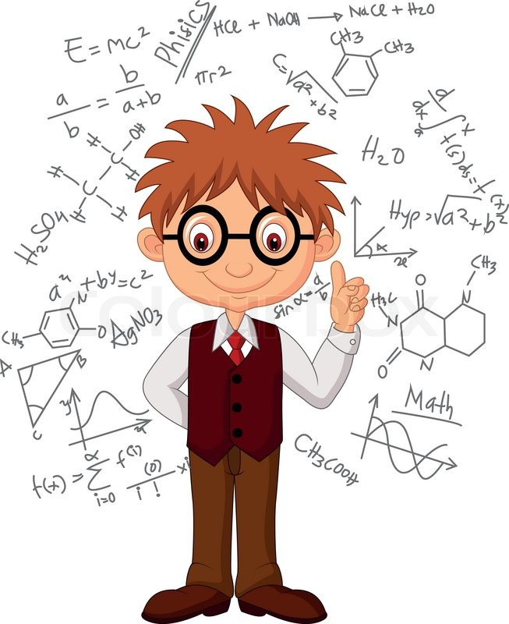

Lesson 1 – What does it mean to learn
Learn from Experience
Learn from Data?
Execute Instructions
Notes:
2 minutes
Now I want to talk a little about what it means for a computer to learn. First lets consider how humans learn, well we learn from experience. When we are young if we touch a hot stove we learn really quickly that doing so was a bad idea and we probably won’t do it again. We learn from our parents, siblings, teachers, and friends.
In contrast a traditional computer program simply executes a given specific set of equations. Like writing information to a file or database or displaying a graphical user interface.
So the question is how would a computer learning, well it can learn from data and I will tell you more about that in the next few slides.

Slide 9
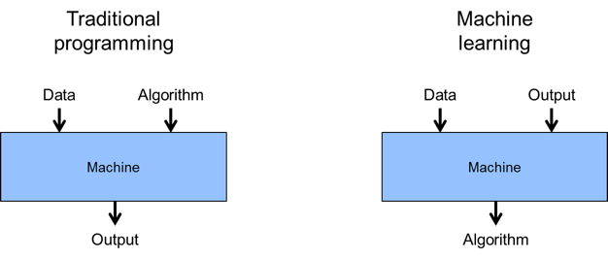
Lesson 1 – How is Machine Learning Different
Notes:
2 minute
To help you better understand the difference between traditional computer programming and machine learning I want to talk through these two diagrams
At first glance they you might think that they are identical, but there is a significant difference.
Lets start with the diagrams on the left. When writing a traditional computer program it is common to design and implement algorithms or functions that can accept data and return a result.
For example maybe you want to convert a number from Celsius to Fahrenheit. Your data would be a number representing a Celsius temperature and the output would be a Fahrenheit value.
In Machine Learning things get turned a little upside down. Again we have data as an input but rather than providing the algorithm we provide the outputs or the answers (label). And through the process of learning the algorithm will be created for us or learned.
.

Slide 10

Lesson 1 – The field of Machine Learning

Slide 11
Lesson 1 – A formal definition
Definition:
A computer program is said to learn from experience E with respect to some class of tasks T and performance measure P, if its performance at tasks in T, as measured by P, improves with experience E. (Tom Mitchell, 1998)

Slide 12
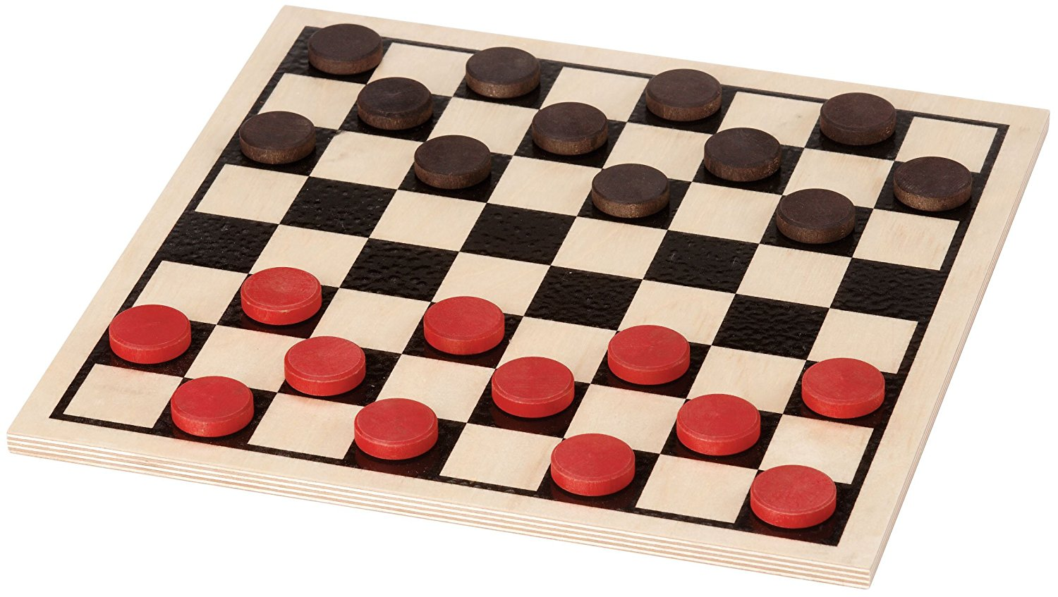
Lesson 1 – Example
Example: Playing Checkers
Task T : playing checkers
Performance P : percentage of games won
Experience E : outcomes of games played

Slide 13
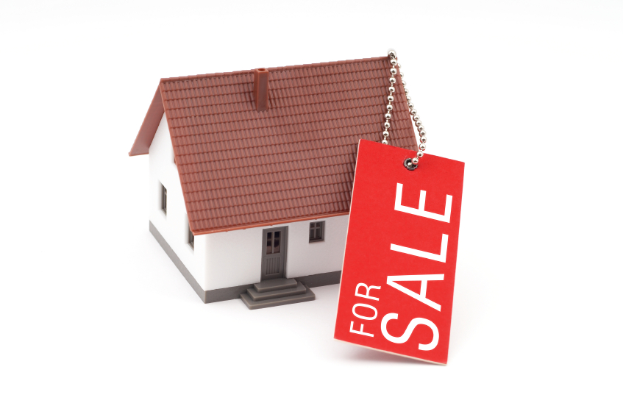
Lesson 1 – Example
Example: Predicting Housing Sale Price
Task T : Given square footage predict sale price
Performance P : How accurate the predicted price is
Experience E : Historical data on home sales over the last few years

Slide 14

Lesson 1 – Example
Example: Recognize Handwritten Digits
Task T : Given an image classify it as a digit (0-9)
Performance P : % of correct classifications
Experience E : A database of images with classification labels

Slide 15

Lesson 1 - Questions

Slide 16
Lesson 1 – Exercise (5 minutes)
Come up with 3-5 Machine Learning examples and define:
Task T
Performance P
Experience E

Slide 17
Lesson 1 - Review
AI vs. ML vs. DL
How ML is different from traditional programing
How to frame a ML problem

Slide 18
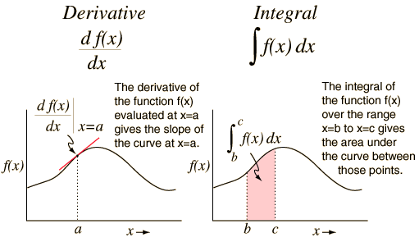
Lesson 2 – Calculus

Slide 19
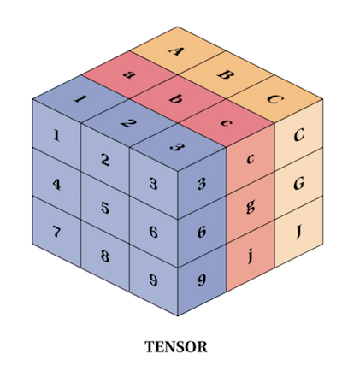
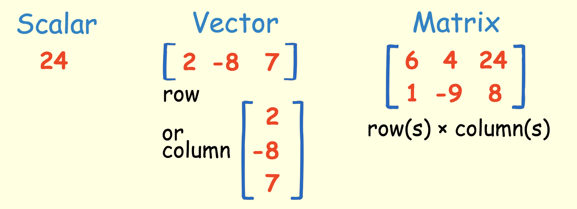
Lesson 2 – Linear Algebra

Slide 20
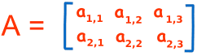
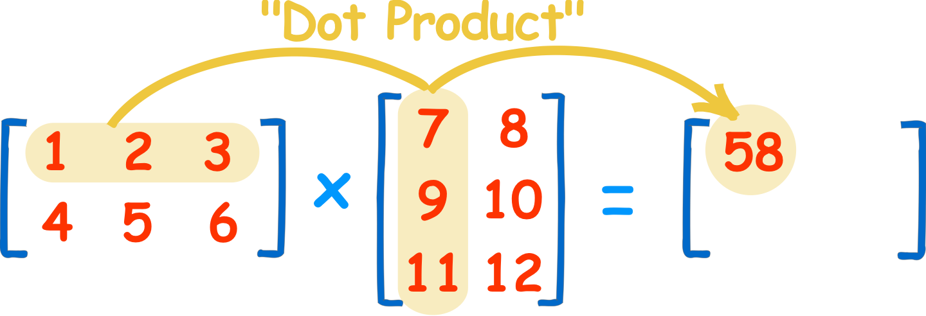
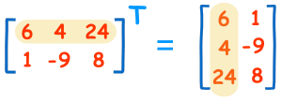
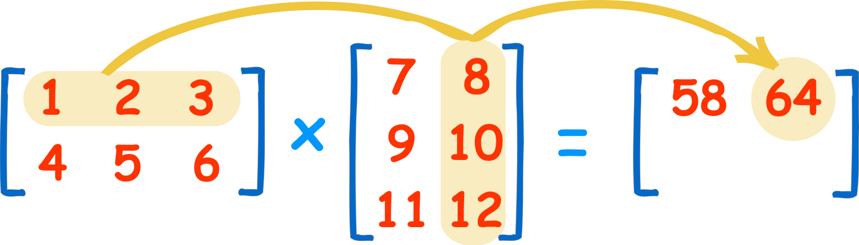
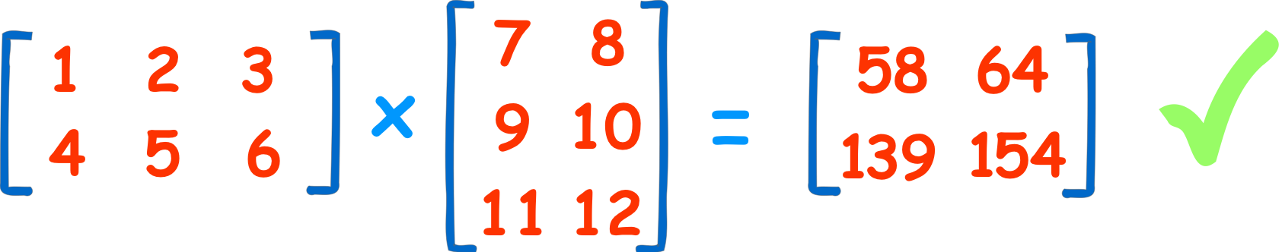
Lesson 2 – Linear Algebra Operations
2x3
3x2
2x3
3x2
2x2

Slide 21
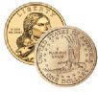

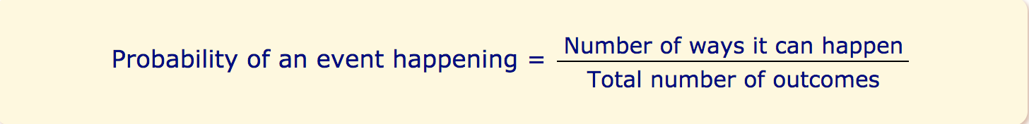
Lesson 2 - Probability

Slide 22
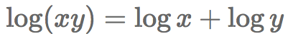
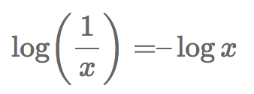
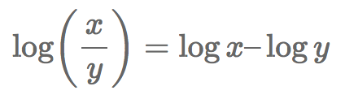
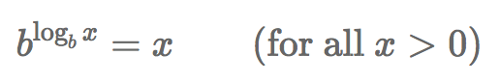
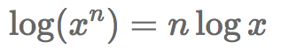
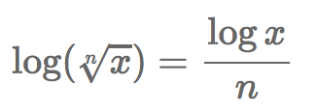
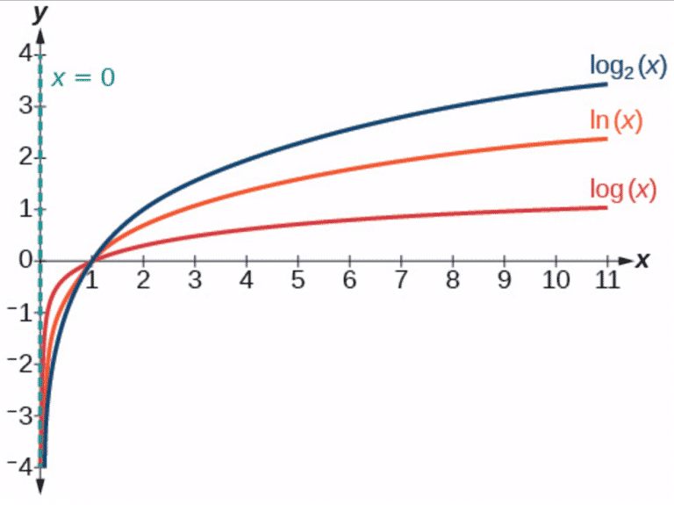
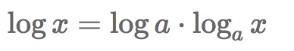
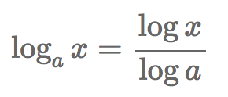
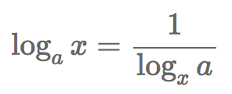
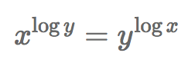
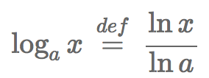
Lesson 2 – Logarithm (log)

Slide 23
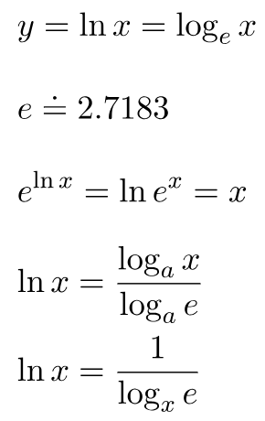
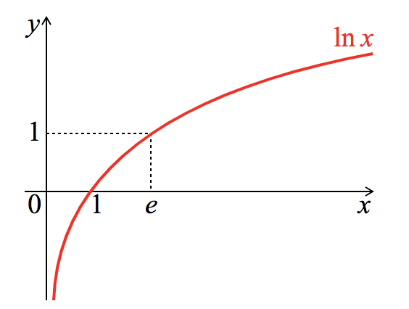
Lesson 2 – Natural Logarithm (ln)

Slide 24
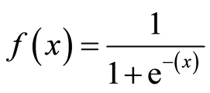
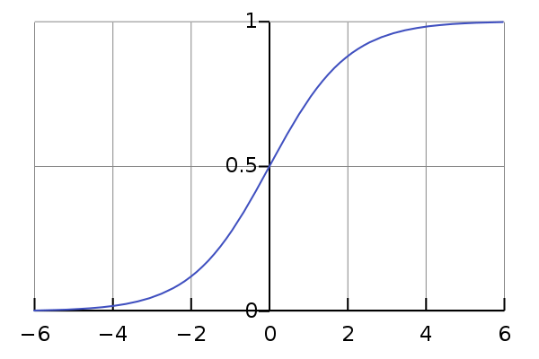
Lesson 2 - Sigmoid

Slide 25
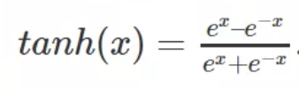
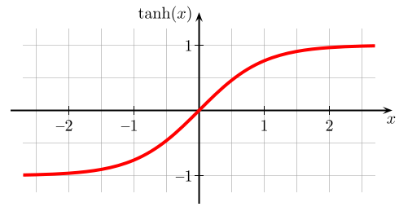
Lesson 2 - Tanh

Slide 26
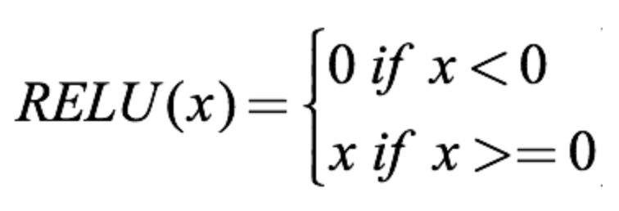
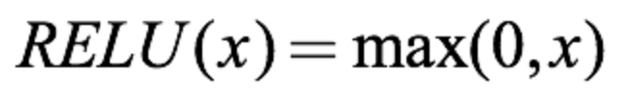
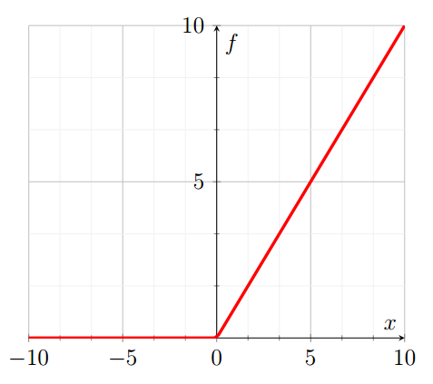
Lesson 2 - ReLU

Slide 27
Lesson 2 - Questions

Slide 28
Lesson 3 – Programming Background
Live Python, Numpy, and Matplotlib demo

Slide 29
Lesson 3 - Questions

Slide 30
Lesson 3 - Exercise
Get familiar with Python, Numpy, and Matplotlib using Colab
Notebook: Intro_Python_Numpy_Matplotlib.ipynb
https://drive.google.com/open?id=1hyv8CRsvgtuTxLllNUCTE-NxTOSGLj37
Create New Notebook
Type each code block from Intro_Python_Numpy_Matplotlib.ipynb into your notebook and run

Slide 31
Lesson 3 - Review

Slide 32
Lesson 4 – Machine Learning Example
Example: Predicting Housing Sale Price
Task T : Given square footage predict sale price
Performance P : How accurate the predicted price is
Experience E : Historical data on home sales over the last few years

Slide 33
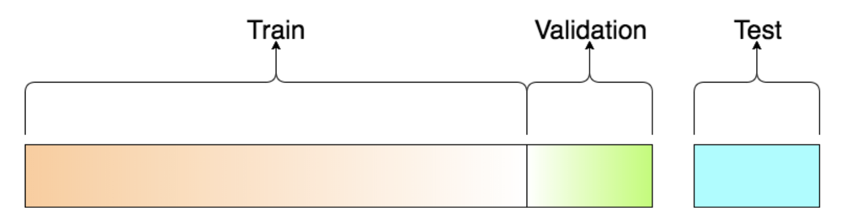
Lesson 4 - Data
[2000,300000]
x (sq. feet)
y (price)

Slide 34
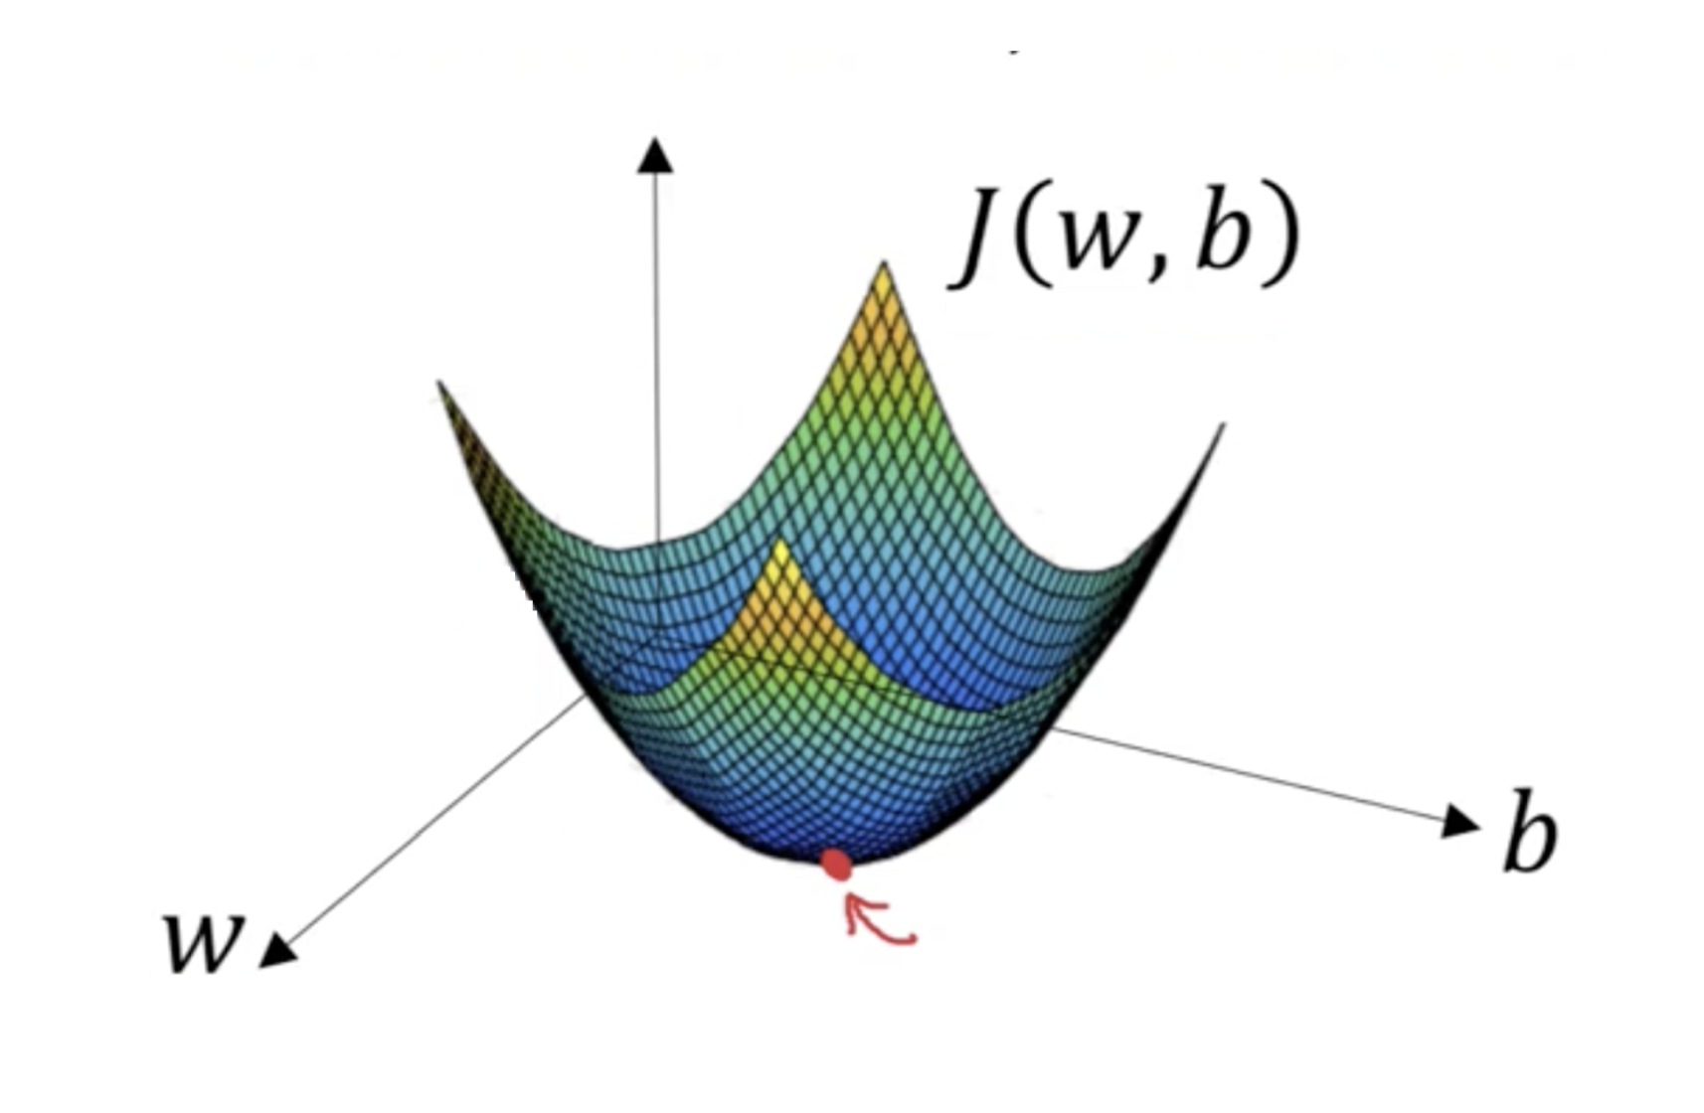
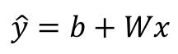
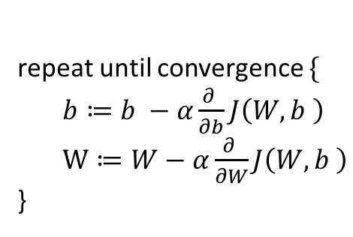
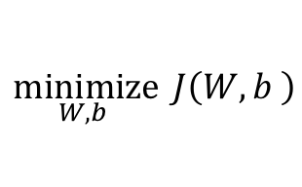
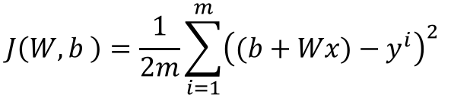
Lesson 4 – Linear Regression
$$\hat{y}=b+Wx$$
$$J\left(W,b \right)=\frac{1}{2m}\sum_{i=1}^{m}{{\left((b+Wx)−y^{i}\right)}^{2} }$$
$
$$\underset{W,b }{minimize}{ J\left(W,b \right)}$$
Price
repeat until convergence $\{$
$b≔b −α\frac{∂ }{∂b}J\left(W,b \right)$
$W≔W−α\frac{∂ }{∂W}J\left(W,b \right)$
}
Square Feet
Notes:
3 minutes
Now lets go through a quick example. Just a quick warning there are equations coming, I don’t want you to get too hung up on them, I just want to highlight that Machine Learning is rooted in math.
So this is a very simple dataset. Basically we are given housing data. The square footage is our input and we are trying to predict the price. Since this is training data we are given both the input (data) and the answer (label).
We want to learn an algorithm what will allow us to predict (forecast) the price of a new home that might come on the market.
A natural predictive model for this simple dataset might be a straight line.
So we all know the equation for line, b is the y intercept and W is the slope x is the square footage and y hat is our prediction.
The process of learning trying to figure out the best value b and the best value for W to fit our data
To do this we will need a way to measure how good the current value for b and W are. We call this a loss function and it is basically the sum of the squared difference between our prediction and the true value.
The dotted red lines represent the difference between our predicted value and the true value.
Our goal is to minimize the loss function to figure out the best b and W values
We can visualize the loss function for this simple model. Since we have a square term the resulting shape would be this bowl shape and we want to find the lowest point on the bowl, which minimizes our loss
To help us find that low point we use something called gradient decent to iteratively walk down the sides of the bowl until we find the lowest point

Slide 35
Lesson 4 – Gradient Decent
Initial
weight
J(w)
Goal
Minimize
J(w)
w

Slide 36
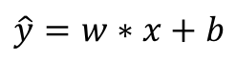
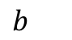
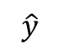
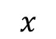
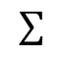
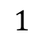
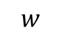
Lesson 4 – Linear Regression as a Graph
$$1$$
$b$
$$\hat{y}=w∗x+b$$
$$x$$
$$∑$$
$$\hat{y}$$
$$w$$
Inputs
Parameters/
Weights
Output
Sum

Slide 37
Lesson 4 - Questions

Slide 38
Lesson 4 - Exercise
Program Linear Regression
Notebook: linear_regression.ipynb
https://drive.google.com/open?id=1iMAMbigS0ZOUiedWGbsCgNcRpBhYbMpV
Create New Notebook
Type each code block from linear_regression.ipynb into your notebook and run

Slide 39
Lesson 4 - Review

Slide 40
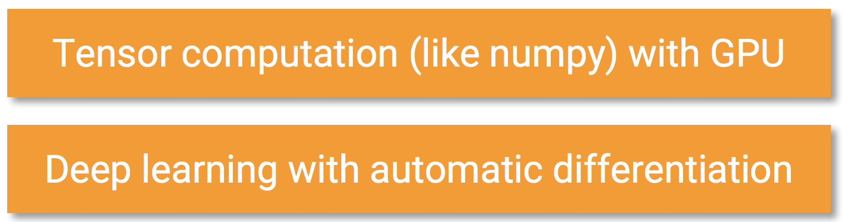
Lesson 5 – PyTorch

Slide 41
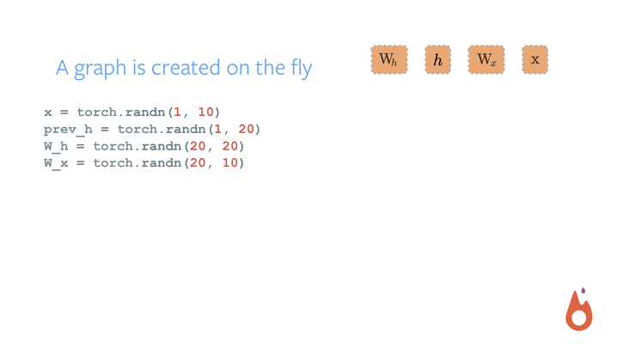
Lesson 5 – PyTorch as Computational Graph

Slide 42
Lesson 5 - PyTorch
Demo

Slide 43
Lesson 5 - Questions

Slide 44
Lesson 5 - Exercise
Program Linear Regression using PyTorch
Notebook: pytorch.ipynb
https://drive.google.com/open?id=1stz1cOIbZevHSokfslZBId4tecdmucVm
Create a New Notebook
Type each code block from pytorch.ipynb into your notebook and run

Slide 45
Lesson 5 - Review

Slide 46

Lesson 6 – Neural Networks

Slide 47














Lesson 6– Early Inspiration
Biological Neuron
Artificial Neuron
$$1$$
$$z= \sum_{j}{W_{j}x_{j}+b}$$
$$\hat{y}=\frac{1}{1+e^{−z}}$$
$$x_{1}$$
$b$
$$w_{1}$$
$$∑$$
$$\hat{y}$$
$$x_{2}$$
$$w_{2}$$
$$x_{3}$$
$$w_{3}$$
Inputs
Parameters/
Weights
Non-linearity
Sum
Output

Slide 48














Lesson 6 – Training (Logistic Regression)
$$z= \sum_{j}{W_{j}x_{j}+b}$$
$$1$$
$$\hat{y}=\frac{1}{1+e^{−z}}$$
$$x_{1}$$
$b$
$$w_{1}$$
$$∑$$
$$z$$
$$J\left(W,b\right)=−\frac{1}{m}[\sum_{i=1}^{m}{y^{i}log⁡(\hat{y^{i}})+(1−y^{i}log⁡(1−\hat{y^{i}})}]$$
$$\hat{y}$$
$$x_{2}$$
$$w_{2}$$
$$x_{3}$$
$$w_{3}$$
$$\underset{W,b }{minimize}{ J\left(W,b \right)}$$
repeat until convergence $\{$
$b≔b −α\frac{∂ }{∂b}J\left(W,b \right)$
$W_{j}≔W_{j}−α\frac{∂ }{∂W_{j}}J\left(W,b \right)$
}

Slide 49









Lesson 6 – Softmax (multi class)
$$z_{i}= \sum_{j}{W_{i,j}x_{j}+b_{i}}$$
$${\hat{y}}_{i}=\frac{e^{z_{i}}}{\sum_{j}{e^{z_{j}} }}$$
$$1$$
$$∑$$
$$\hat{y_{1}}$$
Training similar to logistic regression, but now
we have multiple classes and we need to use
backpropagation to help us build up the gradient
$$x_{1}$$
$$∑$$
$$\hat{y_{2}}$$
$$x_{2}$$
$$∑$$
$$\hat{y_{3}}$$
$$x_{3}$$

Slide 50











Lesson 6 – Stacking Layers
$$1$$
$$1$$
$$1$$
$$1$$
$$1$$
$$\hat{y_{1}}$$
$$x_{1}$$
$$∑$$
$$∑$$
$$∑$$
$$∑$$
X
X
X
X
X
$$\hat{y_{2}}$$
$$x_{2}$$
$$∑$$
$$∑$$
$$∑$$
$$∑$$
$$x_{3}$$
$$∑$$
$$∑$$
$$∑$$
$$∑$$
$$\hat{y_{3}}$$

Slide 51

Lesson 6 – Fully Connected Network

Slide 52


Lesson 6 – MNIST Example
Recognize Hard Written Digits (28x28 grey scale)
60,000 training images
10,000 testing images

Slide 53

Lesson 6 – MNIST Data

Slide 54

Lesson 6 – Flatten Data and feed into network

Slide 55





















Lesson 6 - Training
$$1$$
$$1$$
$$1$$
$$1$$
$$1$$
$$\hat{y_{1}}$$
$$x_{1}$$
$$∑$$
$$∑$$
$$∑$$
$$∑$$
$$\hat{y_{2}}$$
X
X
X
X
X
$$x_{2}$$
.
.
.
.
.
.
.
.
.
.
$$∑$$
$$∑$$
$$∑$$
$$∑$$
$$∑$$
$$∑$$
$$∑$$
$$∑$$
$$\hat{y_{10}}$$
$$x_{784}$$
Forward Propagate Data to calculate Loss
Back Propagate the Loss to calculate Gradient

Slide 56
Lesson 6 - Questions

Slide 57
Lesson 6 – Exercise
Create a simple neural network to classify MNIST
Notebook: mnist_pytorch.ipynb
https://drive.google.com/open?id=1NC1kCL5AIs_LQbbeshjySfrurSdghtrD
Create a new Notebook
Type each code block from mnist_pytorch.ipynb into your notebook and run

Slide 58
Lesson 6 - Review

Slide 59
Lesson 7 - Kaggle
Accounts
Login
https://www.kaggle.com/
Quick overview

Slide 60

Lesson 7 - Computer Vision
Computers gaining a high-level understanding from digital images or video
Image Classification
Object detection
Cat? (0/1)
64x64
Notes:
Define what Computer Vision is: A field that deals with how computers can gain a high-level understanding from digital images or video. Automate the task that the human visual system can do.
Image classification determines if an image has a certain object for example is there a cat.
Object detection goes one step further and determines where in the image a certain object is located
You might be thinking that we already did Image classification last class, and you are right, but the architecture we used (fully connected network) has some issues as our data becomes more complex

Slide 61






Lesson 7 – Issues with the full connected networks
Cat? (0/1)
64x64x3
12,288 total pixels
$$x_{1}$$
$$x_{2}$$
$$⋮$$
$$⋮$$
$$⋮$$
$$\hat{y}$$
$$x_{n}$$
(1000, 3M)
1000x1000x3
3,000,000 (3M) total pixels
3 billion parameters to learn in 1st layer
Notes:
For small images like a 64x64 image of a cat we won’t have any problem scale, 12,288 input units is very manageable
But we have a 1000x1000 color image (3 channels) we will start to have issues with scale. Assume you have 1000 neurons at your first hidden layer. This would result in 3 billion parameters to be learned at the first layer which would take too long to train.
A fully connected network also suffers from losing all the structure of an image since we need to flatten it before feeding the pixels into the network
So we need a better solution

Slide 62

Lesson 7 – Improving the Architecture
Notes:
As our input data get more complex and the dimensions increase a fully connected network will start to become a less attractive option. For one thing they don’t scale particularly well since the architecture is fully connected (a weight to be learned on each connection). Another disadvantage is we lose all the structure of the data when we flatten it.

Slide 63

Lesson 7 – Hubel and Wiesel
Notes:
Work by Hubel and Wiesel (in the 50s and 60s) showed that groupings of neurons in a cat’s visual cortex fire when images of lines and simple curves where shown to the cats.
They showed that there was a special relation between neurons and hierarchical relationships

Slide 64

Lesson 7 - Human vision
Notes:
For images presented to to us
Transforming the image step by step through various regions of the brain
V1 primary visual cortex first step of image processing which performs edge detection
V2 secondary visual cortex responsible for sensing more complex shapes

Slide 65
Lesson 7 – Mapping a CNN to Human Vision

Slide 66


Lesson 7 - Convolution
1
1
-1
0
1
1
0
-1
-1
-1
0
0
3 | 0 | 1 | 2 | 7 | 4
1 | 5 | 8 | 9 | 3 | 1
2 | 7 | 2 | 5 | 1 | 3
0 | 1 | 3 | 1 | 7 | 8
4 | 2 | 1 | 6 | 2 | 8
2 | 4 | 5 | 2 | 3 | 9
1
1
1
1
1
0
-1
0
-1
1
0
-1
1
1
0
-1
0
-1
-1
-1
-1
0
0
0
1 | 0 | -1
1 | 0 | -1
1 | 0 | -1
-5
-4
0
8
1
1
1
1
1
-1
0
-1
0
0
-1
-1
1
0
-1
0
1
0
-1
1
1
0
-1
0
-1
0
-1
1
1
0
-1
1
0
-1
0
-1
$$∗$$
-10
-2
2
3
$$=$$
1
1
1
1
0
-1
0
0
-1
1
0
-1
0
-1
-1
1
0
-1
1
1
0
-1
1
1
0
-1
0
-1
-1
0
1
1
-1
-1
0
0
0
-2
-4
-7
1
0
1
0
-1
1
1
-1
1
0
-1
0
1
0
-1
-1
0
-1
1
1
0
-1
0
-1
-3
-2
-3
-16
Filter (Kernel)
1
0
-1
1
0
-1
1
1
0
-1
0
-1
Feature map
Input

Slide 67



Lesson 7 - Vertical edge detection
10 | 10 | 10 | 0 | 0 | 0
10 | 10 | 10 | 0 | 0 | 0
10 | 10 | 10 | 0 | 0 | 0
10 | 10 | 10 | 0 | 0 | 0
10 | 10 | 10 | 0 | 0 | 0
10 | 10 | 10 | 0 | 0 | 0
0 | 30 | 30 | 0
0 | 30 | 30 | 0
0 | 30 | 30 | 0
0 | 30 | 30 | 0
1 | 0 | -1
1 | 0 | -1
1 | 0 | -1
$$∗$$
$$=$$
$$∗$$

Slide 68



Lesson 7 - Vertical edge detection examples
10 | 10 | 10 | 0 | 0 | 0
10 | 10 | 10 | 0 | 0 | 0
10 | 10 | 10 | 0 | 0 | 0
10 | 10 | 10 | 0 | 0 | 0
10 | 10 | 10 | 0 | 0 | 0
10 | 10 | 10 | 0 | 0 | 0
0 | 30 | 30 | 0
0 | 30 | 30 | 0
0 | 30 | 30 | 0
0 | 30 | 30 | 0
1 | 0 | -1
1 | 0 | -1
1 | 0 | -1
$$∗$$
$$=$$
0 | 0 | 0 | 10 | 10 | 10
0 | 0 | 0 | 10 | 10 | 10
0 | 0 | 0 | 10 | 10 | 10
0 | 0 | 0 | 10 | 10 | 10
0 | 0 | 0 | 10 | 10 | 10
0 | 0 | 0 | 10 | 10 | 10
0 | -30 | -30 | 0
0 | -30 | -30 | 0
0 | -30 | -30 | 0
0 | -30 | -30 | 0
1 | 0 | -1
1 | 0 | -1
1 | 0 | -1
$$∗$$
$$=$$

Slide 69

Lesson 7 – Vertical/Horizontal Edge Detection
1 | 0 | -1
1 | 0 | -1
1 | 0 | -1
1 | 1 | 1
0 | 0 | 0
-1 | -1 | -1
Vertical
Horizontal
10 | 10 | 10 | 0 | 0 | 0
10 | 10 | 10 | 0 | 0 | 0
10 | 10 | 10 | 0 | 0 | 0
0 | 0 | 0 | 10 | 10 | 10
0 | 0 | 0 | 10 | 10 | 10
0 | 0 | 0 | 10 | 10 | 10
0 | 0 | 0 | 0
30 | 10 | -10 | -30
30 | 10 | -10 | -30
0 | 0 | 0 | 0
1 | 1 | 1
0 | 0 | 0
-1 | -1 | -1
$$∗$$
$$=$$

Slide 70



Lesson 7 - Learning to detect edges
1 | 0 | -1
1 | 0 | -1
1 | 0 | -1
1 | 0 | -1
2 | 0 | -2
1 | 0 | -1
3 | 0 | -3
10 | 0 | -10
3 | 0 | -3
Sobel filter
Scharr filter
3 | 0 | 1 | 2 | 7 | 4
1 | 5 | 8 | 9 | 3 | 1
2 | 7 | 2 | 5 | 1 | 3
0 | 1 | 3 | 1 | 7 | 8
4 | 2 | 1 | 6 | 2 | 8
2 | 4 | 5 | 2 | 3 | 9
$w_{1}$ | $$w_{2}$$ | $$w_{3}$$
$w_{4}$ | $$w_{5}$$ | $$w_{6}$$
$w_{7}$ | $$w_{8}$$ | $$w_{9}$$
$$∗$$
$$=$$

Slide 71





Lesson 7 - Strided convolution
2 | 3 | 7 | 4 | 6 | 2 | 9
6 | 6 | 9 | 8 | 7 | 4 | 3
3 | 4 | 8 | 3 | 8 | 9 | 7
7 | 8 | 3 | 6 | 6 | 3 | 4
4 | 2 | 1 | 8 | 3 | 4 | 6
3 | 2 | 4 | 1 | 9 | 8 | 3
0 | 1 | 3 | 9 | 2 | 1 | 4
3
4
4
3
4
3
4
4
4
1
0
2
1
0
1
2
0
2
-1
0
3
4
4
-1
3
0
-1
3
4
4
3
0
3
3 | 4 | 4
1 | 0 | 2
-1 | 0 | 3
3
4
4
91
100
83
1
0
1
0
2
$$=$$
2
1
0
2
$$∗$$
69
91
127
-1
0
3
-1
0
3
4
4
3
-1
0
3
3
4
4
3
4
4
44
71
74
1
0
2
1
0
2
1
0
2
3$× 3$
3$× 3$
-1
0
3
-1
0
3
-1
0
3
7$× 7$

Slide 72
Lesson 7 – Zero Padding
0 | 0 | 0 | 0 | 0 | 0 | 0 | 0
0 |  |  |  |  |  |  | 0
0 |  |  |  |  |  |  | 0
0 |  |  |  |  |  |  | 0
0 |  |  |  |  |  |  | 0
0 |  |  |  |  |  |  | 0
0 |  |  |  |  |  |  | 0
0 | 0 | 0 | 0 | 0 | 0 | 0 | 0
3 | 0 | 1 | 2 | 7 | 4
1 | 5 | 8 | 9 | 3 | 1
2 | 7 | 2 | 5 | 1 | 3
0 | 1 | 3 | 1 | 7 | 8
4 | 2 | 1 | 6 | 2 | 8
2 | 4 | 5 | 2 | 3 | 9

Slide 73
Lesson 7 - Valid and Same convolutions
“Valid”: No padding
“Same”: Pad so that output size is the same as the input size.

Slide 74





Lesson 7 – Calculating the Dimensions
$n × n$ image
$f× f$ filter
padding p
stride s
$\left\lfloor \frac{n+2p −f}{s}+1\right\rfloor$
$\left\lfloor \frac{n+2p −f}{s}+1\right\rfloor$
$$×$$

Slide 75


Lesson 7 - Convolutions on RGB image
$$∗$$
$$=$$
4 x 4

Slide 76




Lesson 7 - Multiple filters
$$∗$$
$$=$$
3 x 3 x 3
4 x 4
6 x 6 x 3
$$∗$$
$$=$$
4 x 4 x 2
3 x 3 x 3
4 x 4

Slide 77


Lesson 7 – Single Convolutional Layer
(
)
$$∗$$
ReLU
+ b1
3 x 3 x 3
4 x 4
(
)
$$∗$$
4 x 4 x 2
ReLU
+ b2
6 x 6 x 3
3 x 3 x 3
4 x 4

Slide 78
Lesson 7 - Max pooling
1 | 3 | 2 | 1
2 | 9 | 1 | 1
1 | 3 | 2 | 3
5 | 6 | 1 | 2
9
2
6
3

Slide 79










Lesson 7 – Convolutional Neural Network
max pool
max pool
5$× 5 ×$ 1 (6)
s = 1
5$× 5 ×$ 6 (16)
s = 1
$$\hat{y}$$
f = 2
s = 2
f = 2
s = 2
$$⋮$$
$$⋮$$
32$×$32 $×$1
28$×$28$×$6
14$×$14$×$6
10$×$10$×$16
5$×$5$×$16
120
84
Feature Learning
Classification

Slide 80

Lesson 7 – Advantages of CNN
10 | 10 | 10 | 0 | 0 | 0
10 | 10 | 10 | 0 | 0 | 0
10 | 10 | 10 | 0 | 0 | 0
10 | 10 | 10 | 0 | 0 | 0
10 | 10 | 10 | 0 | 0 | 0
10 | 10 | 10 | 0 | 0 | 0
0 | 30 | 30 | 0
0 | 30 | 30 | 0
0 | 30 | 30 | 0
0 | 30 | 30 | 0
1 | 0 | -1
1 | 0 | -1
1 | 0 | -1
$$∗$$
$$=$$
Parameter sharing: A feature detector (such as a vertical edge detector) that’s useful in one part of the image is probably useful in another part of the image.
Sparsity of connections: In each layer, each output value depends only on a small number of inputs.

Slide 81
Lesson 7 - Questions

Slide 82
Lesson 7 – Exercise in Colab
Code a Convolutional Neural Network
Load mnist_pytorch_cnn.ipynb from GitHub into colab
https://colab.research.google.com/
https://github.com/EstebanGuillen/DeepLearningClass

Slide 83

Lesson 7 – Open Notebook from GitHub

Slide 84

Lesson 7 – Open Notebook (if previous window did not appear)

Slide 85

Lesson 7 – mnist_pytorch_cnn.ipynb

Slide 86

Lesson 7 – 15 minute Break

Slide 87
Lesson 7 - Review
Computer vision
Edge detection
Convolution
Filter/kernel
Feature map
Stride
Zero padding
Max pooling

Slide 88
Lesson 8 - Fast.ai
“fast.ai is a research lab dedicated to making deep learning more accessible, both through education, and developing software that simplifies access to current best practices.”
Library of the latest techniques
Sits on top of PyTorch

Slide 89

Lesson 8 – ImageNet
1,000 object classes
Data
1.2M training
100k test

Slide 90








Lesson 8 – Transfer Learning
Conv1
max pool
Conv2
max pool
$$⋮$$
$$⋮$$
$$\hat{y}$$
Feature Learning
Classification
X
Conv1
max pool
Conv2
max pool
$$\hat{y}$$
$$⋮$$
$$⋮$$
Feature Learning
Classification

Slide 91
Lesson 8 - Demo
Classify Dog vs Cat
Follow along (your Notebook will be slower)
Load dogs_vs_cats_fastai.ipynb from GitHub into colab
https://colab.research.google.com/
https://github.com/EstebanGuillen/DeepLearningClass

Slide 92
Lesson 8 – Open Notebook from GitHub

Slide 93
Lesson 8 – Open Notebook (if previous window did not appear)

Slide 94

Lesson 8 – dogs_vs_cats_fastai.ipynb

Slide 95

Lesson 8 - Fast.ai Example

Slide 96



Lesson 8 - Load Data and Define Architecture

Slide 97

Lesson 8 - Train the model

Slide 98

Lesson 8 - Find a good Learning Rate

Slide 99

Lesson 8 – Learning Rate Finder Intuition

Slide 100

Lesson 8 - Increasing the Learning Rate

Slide 101

Lesson 8 - Pick a Learning Rate

Slide 102

Lesson 8 - Data Augmentation

Slide 103

Lesson 8 - Training with Data Augmentation

Slide 104

Lesson 8 - Learning Rate Restarts (SGDR)

Slide 105
Lesson 8 – SGDR Intuition
J(w)
w

Slide 106

Lesson 8 - Unfreeze Convolutional Layers
Variable Learning Rates

Slide 107

Lesson 8 - Cycle Mult

Slide 108


Evaluation with Test Time Augmentation (TTA)
Notes:
Original image plus 4 random crops, average result to make prediction

Slide 109

Lessson 8 - Visualize Results

Slide 110
Lesson 8 – 15 minute Break

Slide 111
Lesson 9 – Class Activation Maps
Demo

